Slide 1
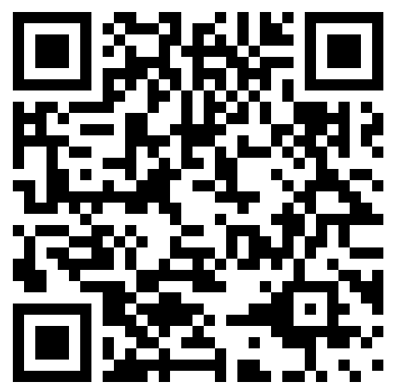


Mascot Update
Preliminary results for ideas are in…
May 5th, 2024
https://tejoin.com/scroll/269398709

Slide 2
Top 20 Names Rated in ThroughtExchange…..so far…..
Red Storm
Red Hawks
Ravens
Raptors
Engineers
Mustangs
Red Tide
Red Thunder
Railriders
Mechanicville M’s
Red Bulls
Cardinals
Railroaders
Conductors
River Rats
Tornadoes
Iron Horses
Big Red
Red Dragons
Mechanics

Slide 3
Some sample comments from the survey…

Slide 5




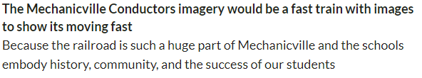

Slide 6
Next Steps

Slide 7

Student cabinet members and building admin review
Results/recommendations to the Board of Education to be reviewed and considered
Board reviews recommended options
Board votes on resolution if/when applicable
New mascot takes effect at designated time
Apparel, fixtures, turf field, furniture, etc. follows schedule to be replaced

Slide 8
Questions/Comments

