Slide 1
Proposed Budget Presentation
Mrs. Jodi Birch
Business Manager

Slide 2
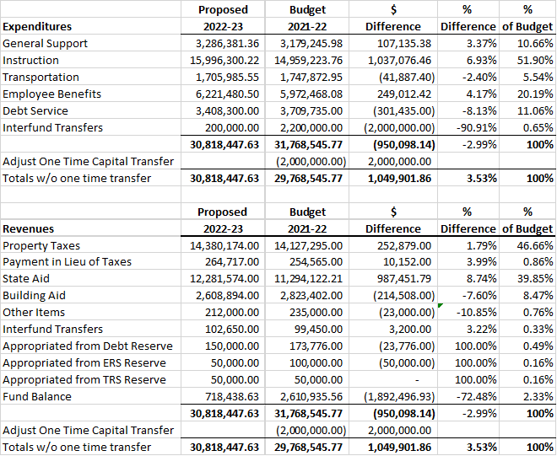

Slide 3
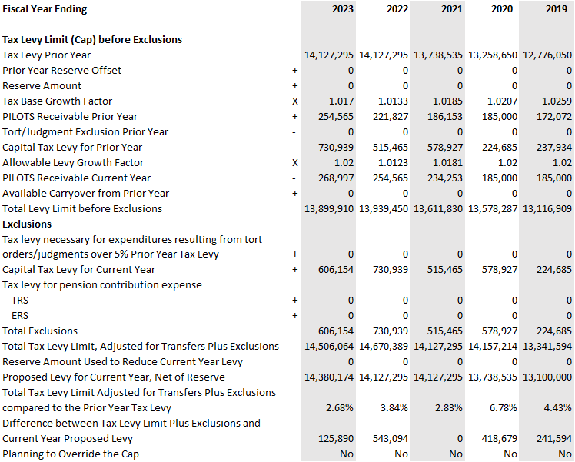

Slide 4
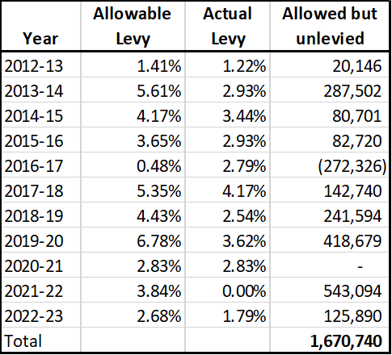
Tax Levy History

Slide 5
General Fund Program/Facilities Enhancements
1.0 FTE Business teacher
1.0 FTE Technology teacher
1.0 FTE Foreign language teacher
1.0 FTE Cafeteria monitor (ES)
Replace Jr/Sr High Gymnasium Speaker System
Football blocking sled
Lighting repair MS Auditorium
Window repairs at the Elementary school
Lighting for the flagpole on athletic field
10 new water bottle fillers

Slide 6
Voting and Ballot
Voting will take place on Tuesday, May 17th from noon until 9:00 pm in the High School gymnasium
Approve the proposed budget of $30,818,448 – 1.79% increase in taxes
To elect three (3) members of the Board of Education to three (3) year terms each commencing on July 1, 2022 and expiring on June 30, 2025 to succeed John Bove, John Taglione and Tim Coleman whose terms expire on June 30, 2022.
To approve the purchase of a bus garage facility at a cost not to exceed $2.3 million, to be allocated from excess fund balance and have no impact on the tax levy.

