Slide 1
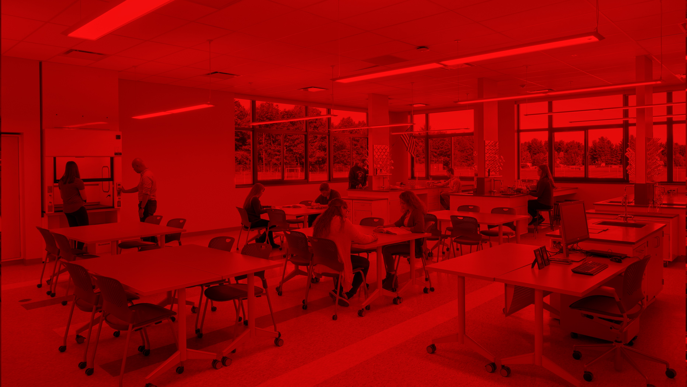
MECHANICVILLE CITY SCHOOL DISTRICT
Presentation to the Board of Education
3.16.2022

Slide 2
Overview of Remaining $9.3M Total Capital Project
Bus Garage Options
Recommendation
Phase 1 & 2 Remaining Scope
Schedule

Slide 3
Overview of Remaining $9.3M Capital Project

Slide 4
Overview of Project Scope
Remaining $9.3M Total Capital Project Funds (+/-$7.75M Allowable Construction)
PHASE 1
Jr/Sr. HS Auditorium Roof Replacement (estimated at $459,207)
PHASE 2
Scope to-be-determined with remaining budget, Target areas:
Bus Garage (3 options)
Softball Field
Demolition of Existing Bus Garage & Parking Lot Reconfiguration
Elementary School Band Room
Mill and Pave Access Road from Jr/Sr. HS to ES
New Road from Elizabeth Street Extension (@ Zim Smith) to ES Access Road

Slide 5
Bus Garage Options

Slide 6
Option 1 - Existing Location
Option 1
Build a New Bus Garage at Existing Location

Slide 7
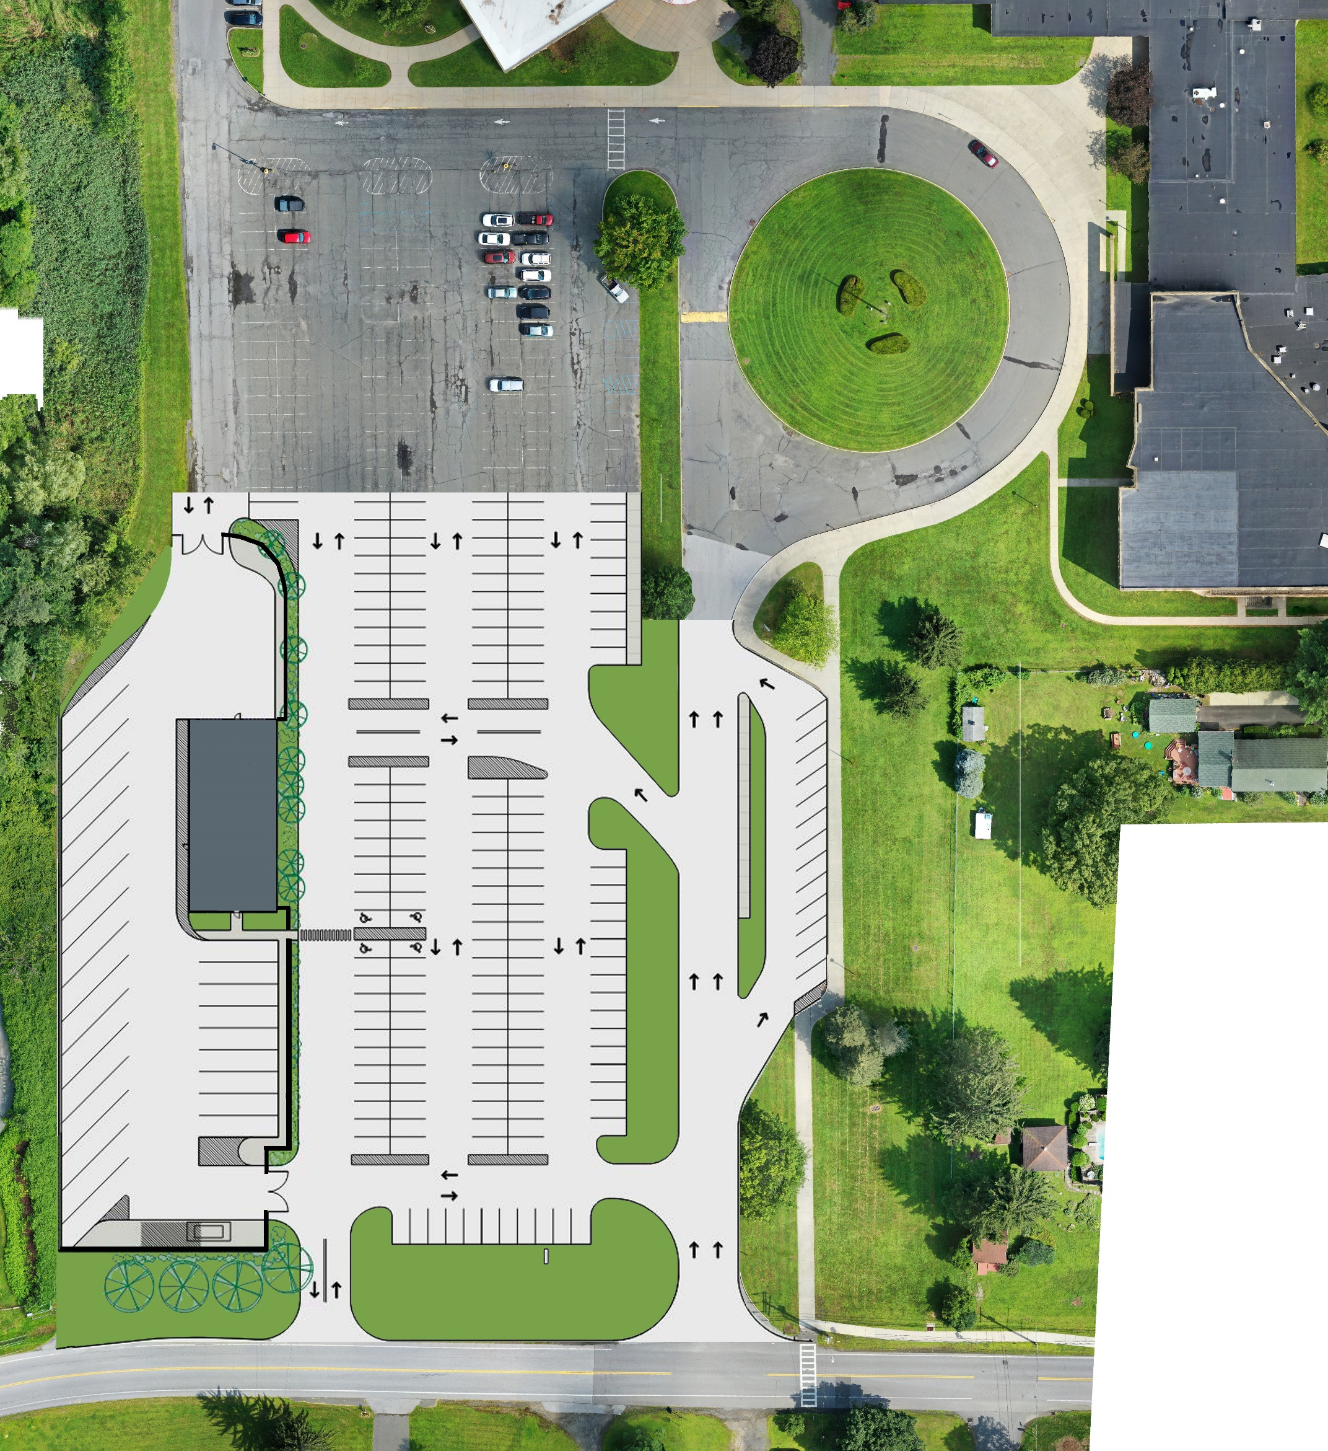
2017 Proposed Bus Garage
Option 1 – Existing Location
Summary:
Demolish existing Bus Garage
Build new Bus Garage- 4,500 sf
Reconfigure remaining parking lot
Pros:
Single construction area
Cons
Impacts current Operations and Traffic
Unattractive entry to campus
Restricts options for improved vehicle traffic
Uses space that could otherwise be additional parking
Maintains only one way on/off campus

Slide 8
Option 2 – New Location
Option 2
Build a New Bus Garage at New Location on Campus

Slide 9
Option 2- New Location
Option 2 – New Location
Summary:
Build new Bus Garage- 5,200 sf
Build new road from Elizabeth St. Ext. to the proposed Bus Garage
Pros:
Allows for more welcoming sightlines at campus entry (demolish existing bus garage)
More remote location from school buildings – could be a negative also.
No impact on current operations
Cons
High cost to re-grade and develop site
Need to extend all utilities to site
Higher cost stretches already stretched previous referendum funds
(Plan by Bonacci Architects)

Slide 10
Option 3 – Building Purchase
Option 3
Purchase Building at Nearby Off-Campus Site

Slide 11
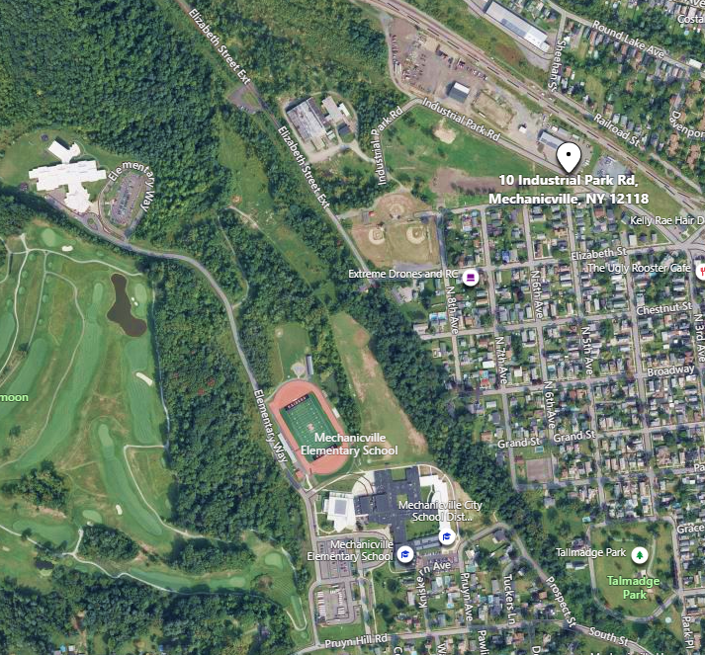
Option 2- New Location
Option 3 – Building Purchase
Summary:
Purchase existing off-campus building to use for Bus Garage
10 Industrial Park Drive
10,000 sf building + Covered Storage
Constructed in 2019; Office Addition in 2021

Slide 12
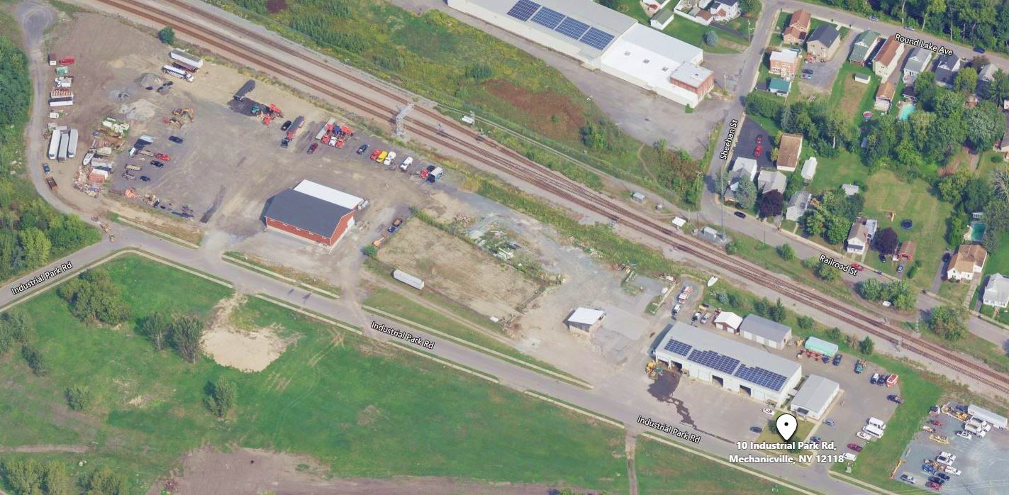
Option 3 – Building Purchase

Slide 13
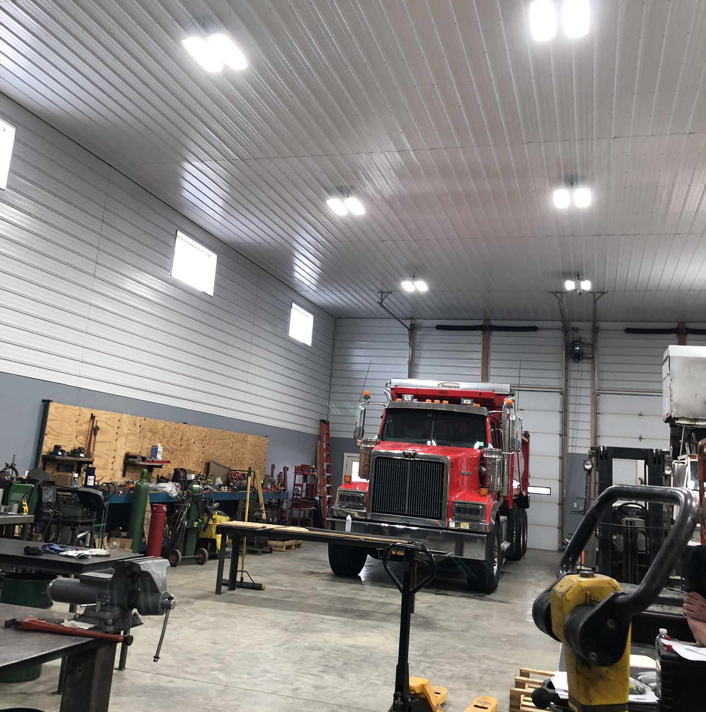
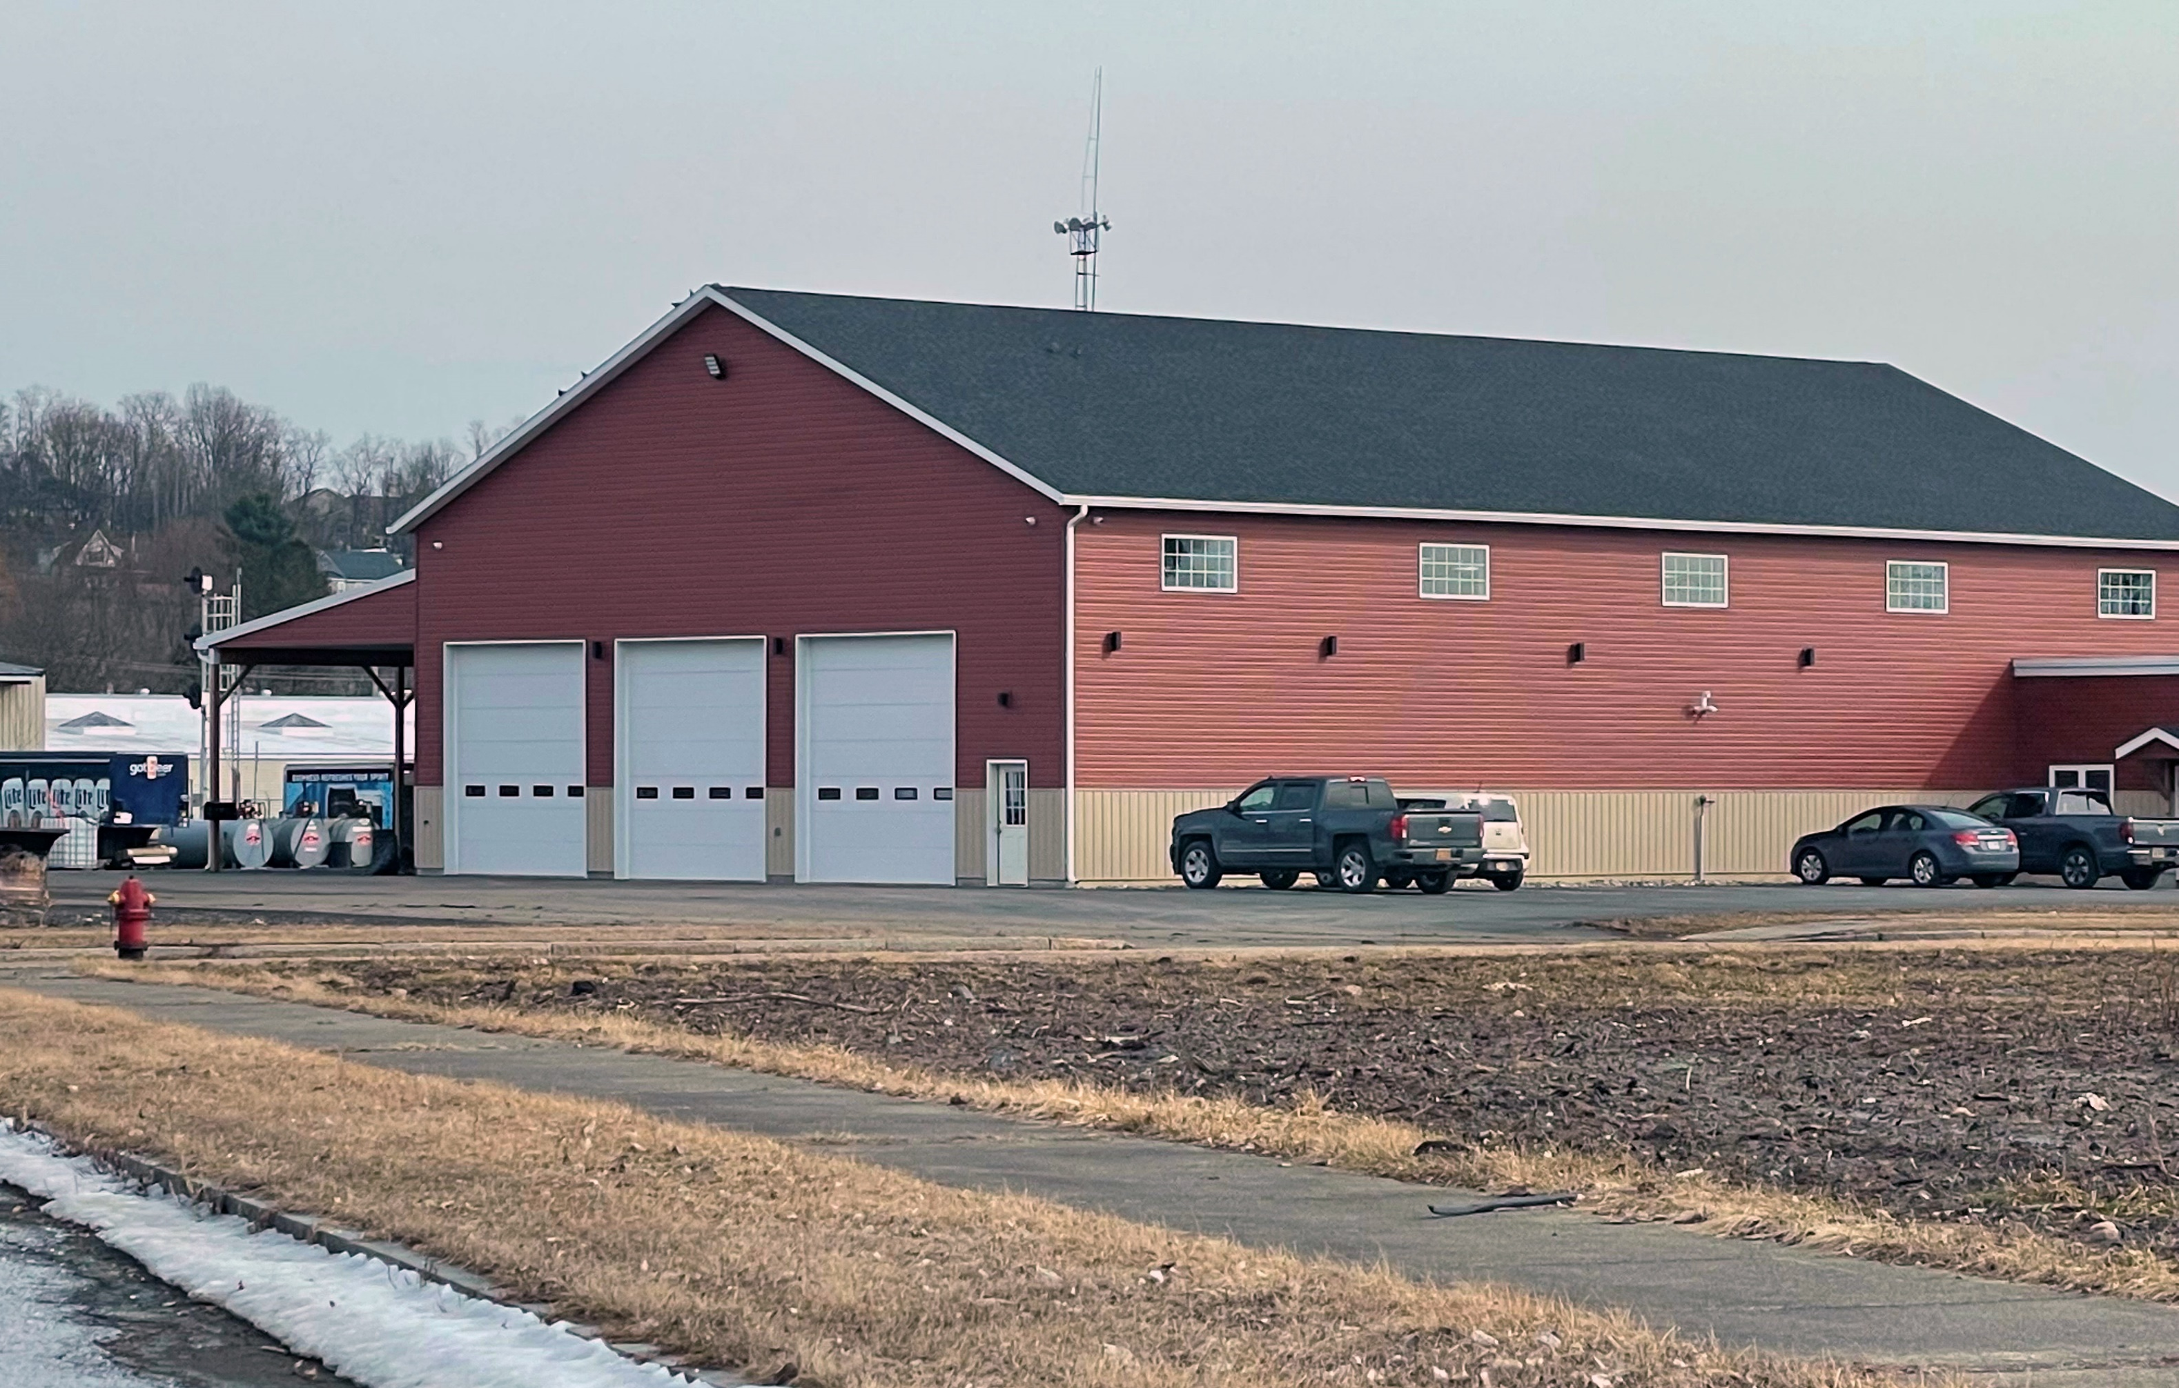
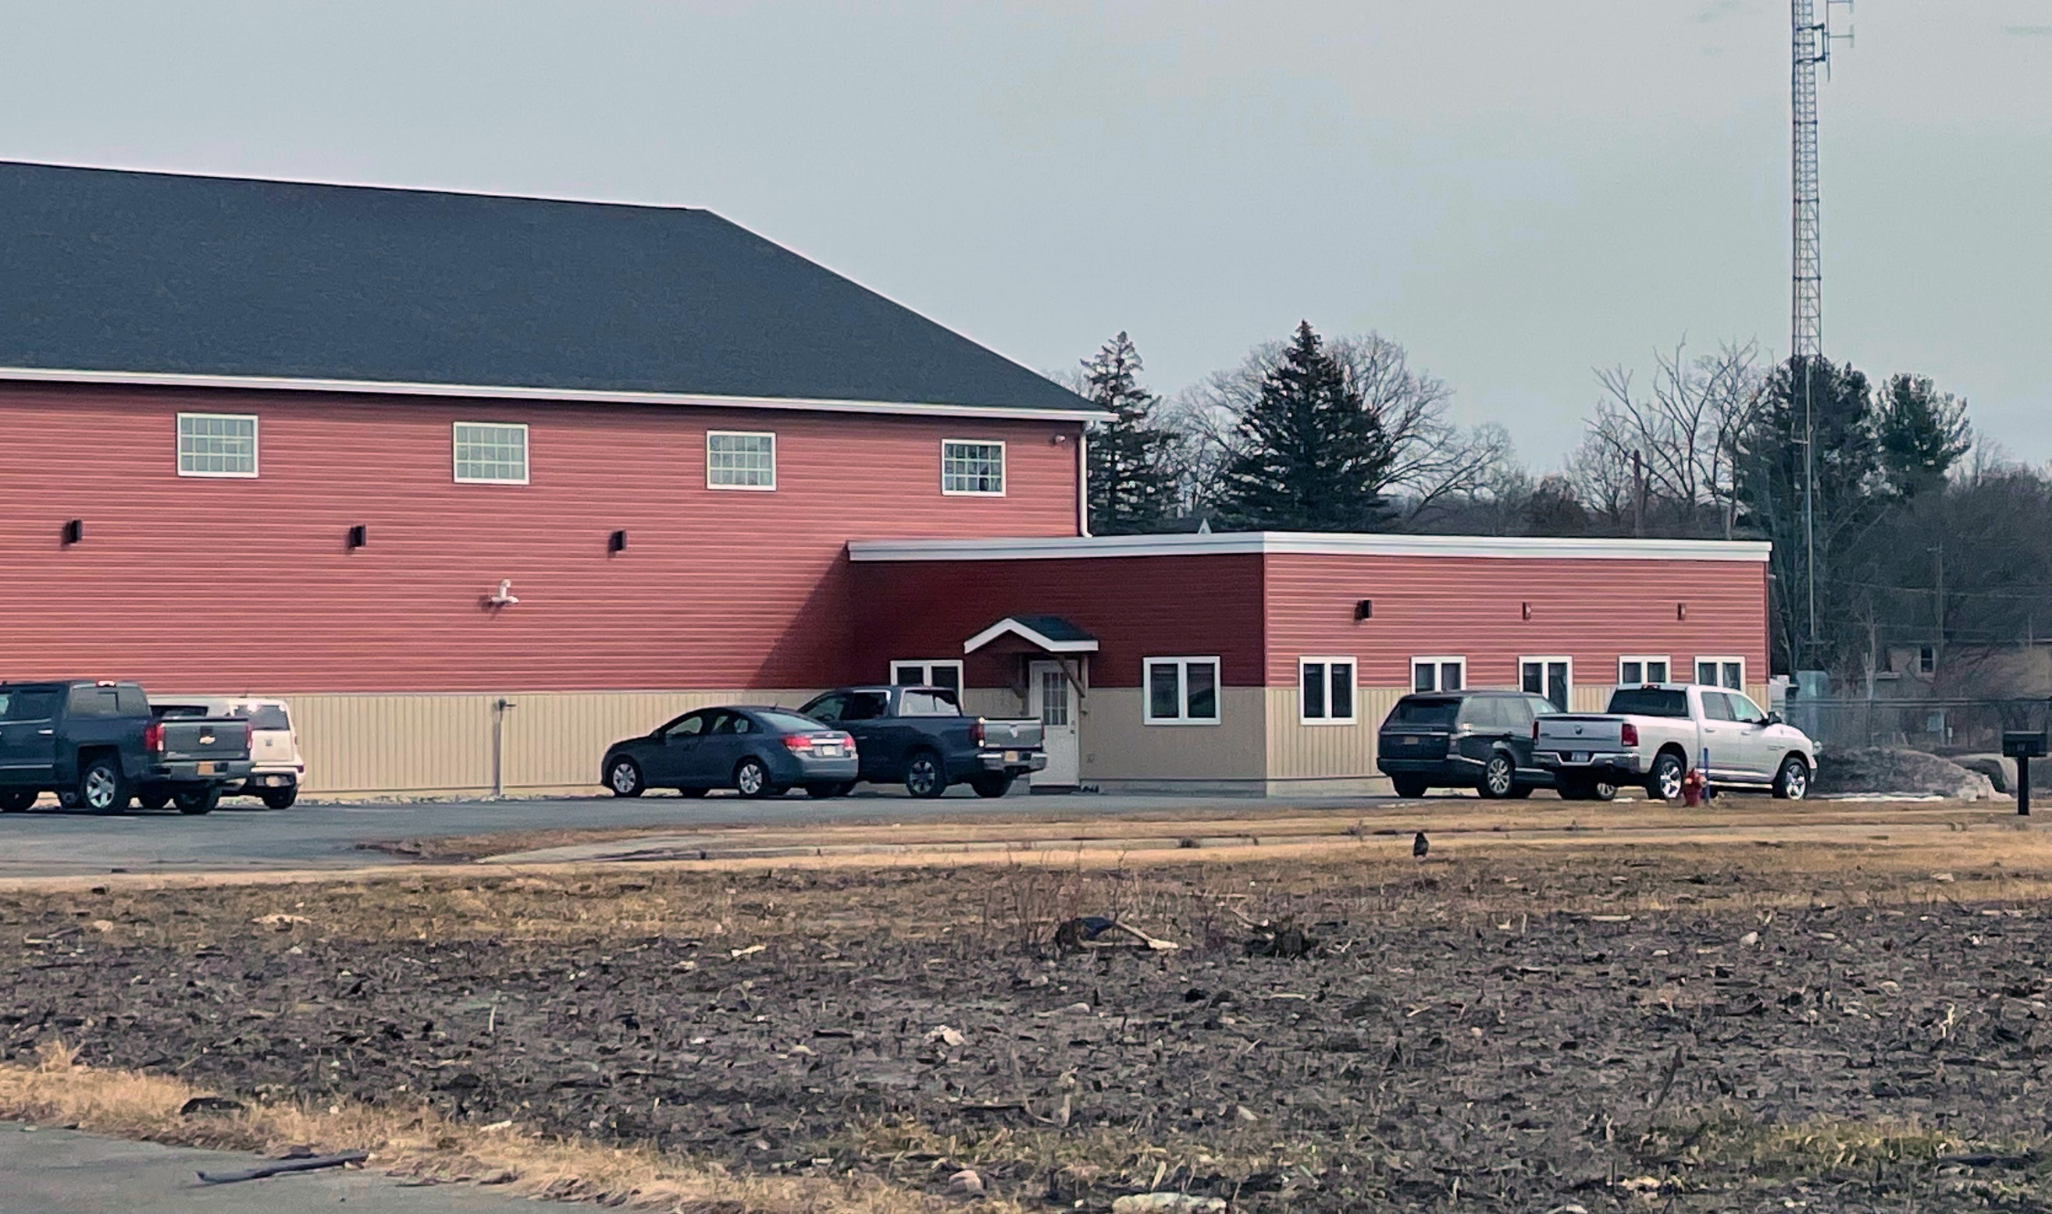
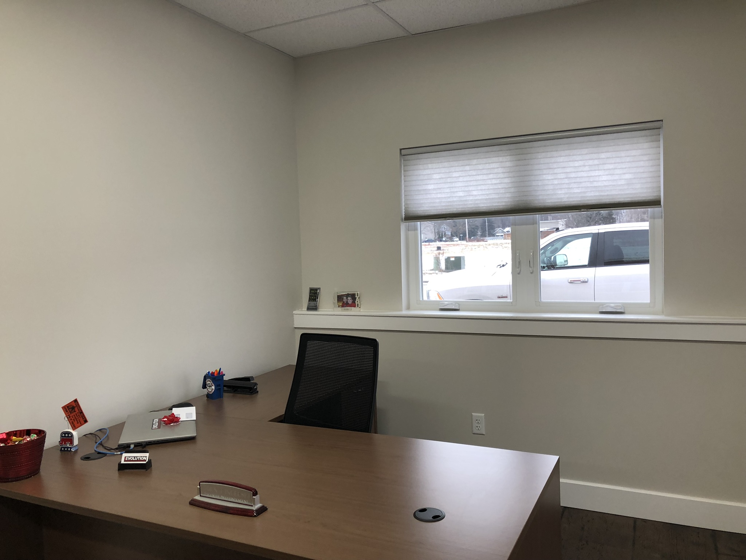
Option 3 – Building Purchase
Proposed Building/Site Purchase

Slide 14
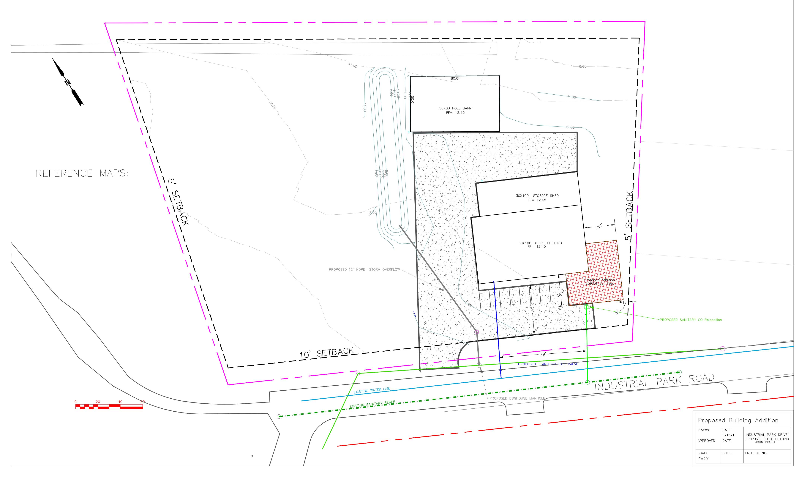
Option 3 – Building Purchase
Proposed Building/Site Purchase
Existing property map from current owner

Slide 15
Recommendation

Slide 16
Option 2- New Location
Recommendation
Summary:
Purchase existing (new) off-campus building to use for Bus Garage
Pros:
New building and site ideal for Bus Garage – current industrial location
Removes Garage from front of Jr/Sr HS
Allows for more parking and better traffic flow at Jr/Sr HS
No Impact on current operations; improved occupancy schedule
Larger Garage – allows for appropriate size support spaces and potential relocation of other spaces from Jr/Sr HS
More economical $/sf vs. new garage on school property
Use of excess fund balance allows for referendum funding to be preserved for roof, sitework, program space, etc.

Slide 17
Phase 1 & 2 Remaining Scope

Slide 18
Overview of Project Scope
Remaining $9.3M Total Capital Project Funds (+/-$7.75M Allowable Construction)
PHASE 1
Jr/Sr. HS Auditorium Roof Replacement (estimated at $459,207)
PHASE 2
Scope to-be-determined with remaining budget, Target areas:
Softball Field
Demolition of Existing Bus Garage & Parking Lot Reconfiguration
Elementary School Band Room
Mill and Pave Access Road from Jr/Sr. HS to ES
New Road from Elizabeth Street Extension (@ Zim Smith) to ES Access Road

Slide 19
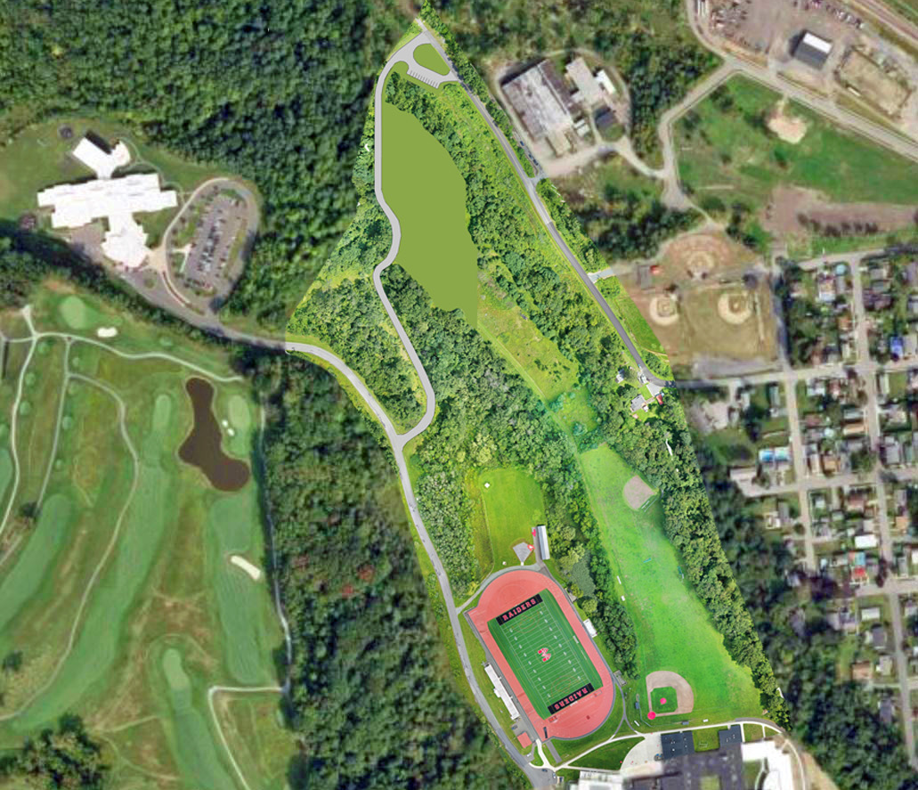
Proposed Connector Road

Slide 20
Schedule for Phase 1 & 2
PHASE 1 – Jr/Sr HS Roof Replacement
Define Scope October 2021
Design Phase November – December 2021
SED Submission Complete December 27, 2021
SED Review & Approval (estimated) January 2022 – March 2022
Co-Op Procurement April 2022
Construction June – August 2022
Project Closeout Fall 2022
PHASE 2 – Remaining Scope
Programming and Design Phase April 2022 – November 2022
SED Review & Approval (est.) December – March 2023
Bidding & Contract Award April-May 2023
Construction June 2023 – Fall 2024
Project Closeout December 2024

