Slide 1

Superintendent’s
Coffee Chat
February 3, 2021
Plan for Return to In Person and Hybrid Learning
Plan for Start of High Risk Winter Sports

Slide 2
It is our obligation to support each member of our Community of Learners as we continue to plan for the unknown in an uncertain environment. As we made adjustments throughout this pandemic, we have always made decisions to best meet the needs of each school community member, attempting to meet them where they are at in an equitable manner.
We will continue to prioritize parent choice, maximizing in person instruction and focus on supporting social and emotional needs. As a district, we re-evaluated our reopening plan.
Moving forward we will continue to wear masks 100% of the time. We’ve already upgraded our cleaning protocols. Our number one priority is the physical health and mental wellness of every school community member!

Slide 3
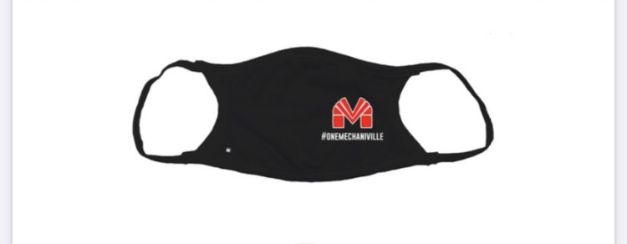
We are purchasing masks for all students and staff from Val’s Sporting Goods

Slide 4
RETURN TO SCHOOL PLAN
School will return to in person and hybrid instruction following February break
  On February 4th - all 248 ES in person learners will be sent home with a form asking if the need a device. Those students needing one will take a chromebook home on February 12th
  Monday, February 22 - ALL STUDENTS K-12 will learn virtually at home in a live format following the instruction of their teacher
    K-3 instruction is 8:00 - 1:00
    4-6 instruction is 9:00 - 2:00
    7-12 instruction is 10:00 - 3:00
      This schedule will remain and we will return to 3 bus runs

Slide 5
The District is hosting a COVID-19 Rapid Testing Clinic for all employees on Monday, February, 22
Adirondack Health and Wellness will test every employee with the following exceptions:
    Employees who have had COVID-19 will not participate in the clinic
    Employees having both vaccine shots will not participate in the clinic
    Employees demonstrating any COVID-19 symptoms will isolate at home and follow up with their physician and not participate in the clinic
Pending a successful testing clinic all in person and hybrid learning begins on Tuesday, February 23
    K-6 and special class exceptional learners will return to in person learning daily
    7-12 students will return to a hybrid model (Red and White)
      Red students will be in person Monday and Thursday
      White students will be in person Tuesday and Friday
      We will continue our virtual Wednesday model personalizing learning for each student. Full school day schedule remains as is currently.

Slide 6
NEXT STEPS
We will be sending an electronic registration form to all families to decide if their student will be returning for in person and hybrid learning after February break.
  So that Mike Pratt has the necessary information to create bus runs and faculty will be aware if their students are in person or virtual we ask that this be completed by Friday, February 12
Mr. Mitchell will be sending surveys to students and parents asking for feedback on how Wednesday’s have been going at the Jr/Sr HS
We will be sending a form home with our current in person learners at the ES asking parents if their students need a device for our full virtual day on Monday, February 22
  Any student needing a device will bring a chromebook home on Friday, February 12

Slide 7
Questions and Answers
Regarding Return to In Person and Hybrid Learning

Slide 8
HIGH RISK WINTER SPORTS
On January 22, Governor Cuomo approved the start of high risk sports beginning on February 1st with local Department of Health approval
On January 29, the Saratoga County Board of Supervisors approved the start of high risk sports with the following criteria:
  Each school district’s Board of Education must approve the school’s participation in each specific higher-risk sport.
  Each school superintendent must oversee the creation of a sport specific preparedness plan, to be approved by the district’s medical director.
  Each parent/guardian must sign an informed consent.
  Each student-athlete must have medical clearance from their healthcare provider.
  Each parent/guardian, student-athlete, and school official must agree to fully cooperate with case investigations and contact elicitation and to adhere to isolation and quarantine orders.
  Each district must establish a confidential phone number and email address to allow student-athletes, parents, or others to report concerns.
  Saratoga County’s 7-day rolling average positivity rate must be less than 4%

Slide 9
HIGH RISK WINTER SPORTS
Dr. Carl Sgambati, District Physician approved the following high risk sports:
  Boy’s and Girl’s Basketball
  Cheerleading
  Wrestling
At the regularly scheduled BOE meeting tomorrow night, the BOE will be asked to approve a resolution allowing MCSD to offer those high risk sports for the winter season.
AD, Tom Berrigan has been developing protocols and systems required as directed by the Saratoga Board of Supervisors and Department of Public Health
  He is working closely with coaches of each individual team
  He is creating equitable practice times for all teams
    Due to space limitations, Stillwater will be hosting Red Warrior Wrestling practices.
  He is aligning every single protocol to match those approved by Dr. Sgambati

Slide 10
HIGH RISK WINTER SPORTS
There is a formal proposal for an 8 school league comprised of Saratoga County Schools
  This proposal is not finalized, there is a meeting of all Athletic Directors representing the schools involved. Draft schedules for basketball have been created for JV and Varsity.
  Mechanicville is committed to creating intramural programs for boys and girls basketball. If there are other schools within this 8 team league we hope to have competitive games for modified teams, but we are awaiting further information.
  As of today, only 3 schools have approved wrestling. 2 of which are merged, Mechanicville & Stillwater.
Corinth
Galway
Mechanicville
Saratoga Catholic
Schuylerville
South Glens Falls
Stillwater
Waterford-Halfmoon

Slide 11
HIGH RISK WINTER SPORTS
Whether we participated in the Wasaren League, or this new 8 team Saratoga County League, the difficult decision was made only to allow game personnel and team members into each sporting event. As this is very disappointing for families and fans, each school district has made the commitment to live stream all games and contests.
This eliminates nearly 100 additional adults from entering each school gymnasium, whereby contact tracing, spacing, and supervision of people on the very strict requirements put forth in documents by NYSPSHAA as well as Saratoga County Department of Health and Dr. Sgambati.
As a father of an athlete, I would much prefer to watch my son in person. But given the inherent risk of bringing 100 spectators to the game and the potential mandatory quarantine risk if any person then tested positive puts our student athletes participation at risk.
Lastly, because each school will be live streaming games, now friends, relatives, and student peers will be able to watch our student athletes compete.

Slide 12
Questions and Answers
Regarding High Risk Sports

